Slide 1
http/P H I S H I N G url.com
ETHICAL HACKING PROJECT
2K19/CO319 RITIK SINGH

Slide 2
What is Phishing?
(a) • Phishing is a form of Cybercrime.
• Phishing is the attempt to obtain sensitive information such as usernames, passwords, and credit card details (and, indirectly, money), often for malicious reasons, by disguising as a trustworthy entity in an electronic communication.
• Phishing is the process of enticing people into visiting fraudulent websites and persuading them to enter identity information such as usernames, passwords etc.

Slide 3
What is Phishing?
(b) • Phishing, the act of stealing personal information via the internet for the purpose of committing financial fraud.
• Rely on unsolicited communications by email, SMS or telephone. • The attacker purports to represent a third reliable party.
• An attempt to convince the victim to divulge sensitive information, such as login credentials or payment details.

Slide 4
Types of Phishing
Mass Phishing – Mass, large-volume attack intended to reach as many people as possible
Spear Phishing – Targeted attack directed at specific individuals or companies using gathered information to personalize the message and make the scam more difficult to detect
Whaling – Type of spear phishing attack that targets “big fish,” including high-profile individuals or those with a great deal of authority or access
Clone Phishing – Spoofed copy of a legitimate and previously delivered email, with original attachments or hyperlinks replaced with malicious versions, which is sent from a forged email address so it appears to come from the original sender or another legitimate source
Advance-Fee Scam: Requests the target to send money or bank account information to the cybercriminal

Slide 5
Common Baiting Tactics
Notification from a help desk or system administrator Asks you to take action to resolve an issue with your account (e.g., email account has reached its storage limit), which often includes clicking on a link and providing requested information.
Advertisement for immediate weight loss, hair growth or fitness prowess Serves as a ploy to get you to click on a link that will infect your computer or mobile device with malware or viruses.
Attachment labeled “invoice” or “shipping order” Contains malware that can infect your computer or mobile device if opened. May contain what is known as “ransomware,” a type of malware that will delete all files unless you pay a specified sum of money.
Notification from what appears to be a credit card company Indicates someone has made an unauthorized transaction on your account. If you click the link to log in to verify the transaction, your username and password are collected by the scammer.
Fake account on a social media site Mimics a legitimate person, business or organization. May also appear in the form of an online game, quiz or survey designed to collect information from your account.

Slide 6
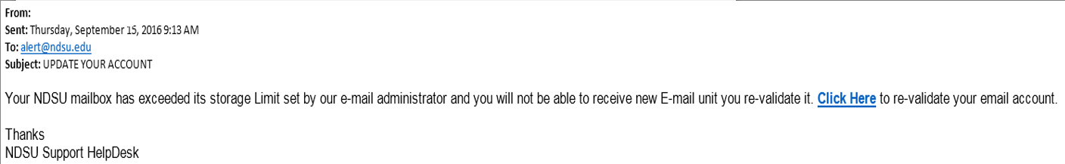
Phishing Lure
Claims to come from the NDSU IT Help Desk and system administrators
References NDSU and North Dakota State University
Calls for immediate action using threatening language
Includes hyperlink that points to fraudulent site

Slide 7
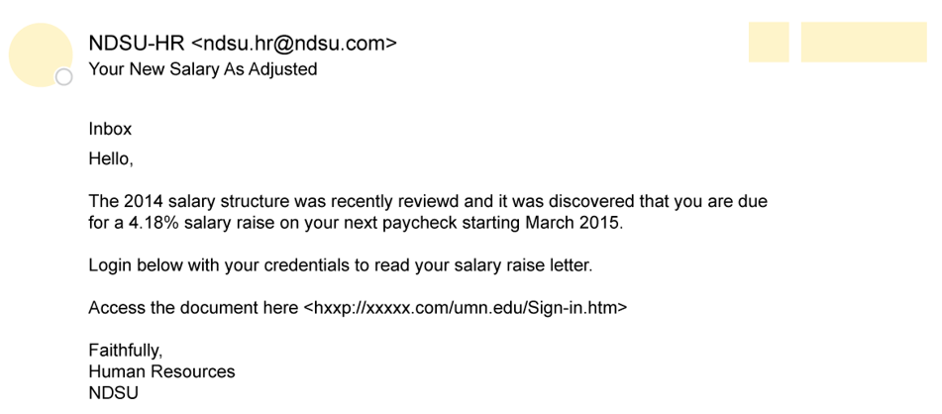
Phishing Lure
Claims to come from the NDSU Human Resources
Timely call for action during annual review season
From address includes NDSU, but not .edu address (@ndsu.com)
Includes hyperlink that points to fraudulent site

Slide 8
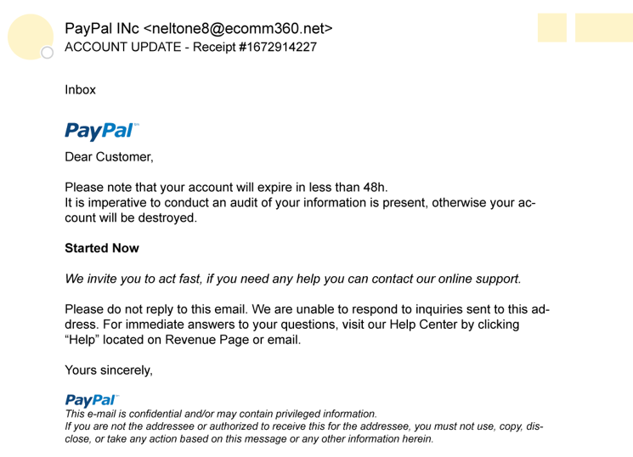
Phishing Lure
Claims to come from PayPal
Includes PayPal logo, but from address is not legitimate (@ecomm360.net)
Calls for immediate action using threatening language
Includes hyperlink that points to fraudulent site

Slide 9
Detect a Phishing Scam
Spelling errors (e.g., “pessward”), lack of punctuation or poor grammar
Hyperlinked URL differs from the one displayed, or it is hidden
Threatening language that calls for immediate action
Requests for personal information
Announcement indicating you won a prize or lottery
Requests for donations

Slide 10
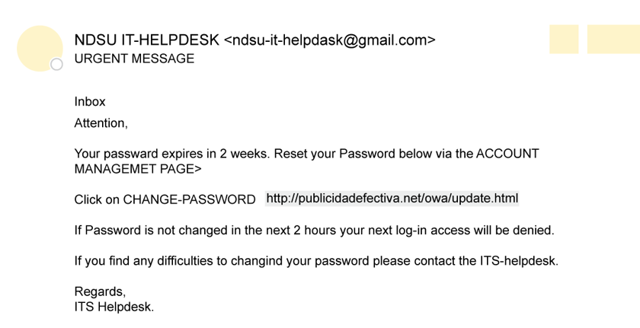
Can you detect a phishing scam?

Slide 11
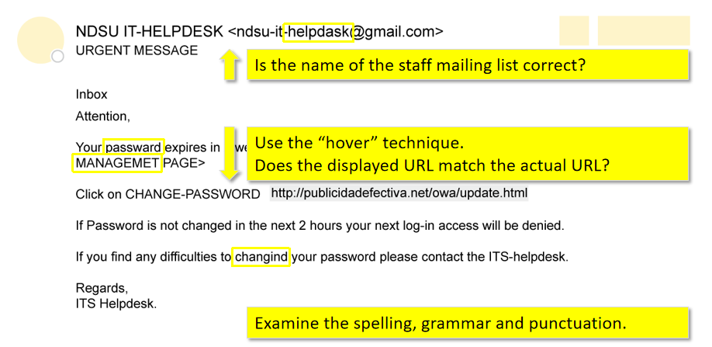

Slide 12
LockPhish
It is designed for phishing attacks on the lock screen, designed to grab Windows credentials, Android PIN and iPhone Passcode using a https link.

Slide 13
Features:
Lockscreen phishing page for Windows, Android and iPhone
Auto detect device
Port Forwarding by Ngrok
IP Tracker

Slide 14
Ngrok
Ngrok is a cross-platform application that exposes local server ports to the Internet.
Their website claims, “[so you can] spend more time programming—one command for an instant, secure URL to your localhost server through any NAT or firewall.”

Slide 15
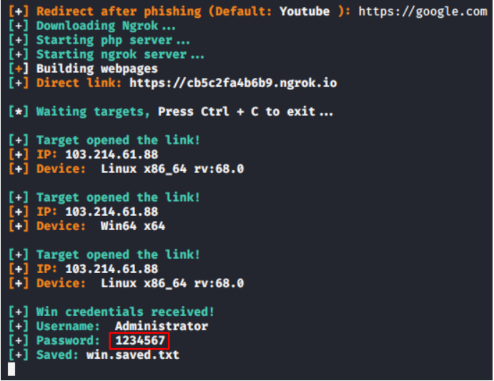

Slide 16
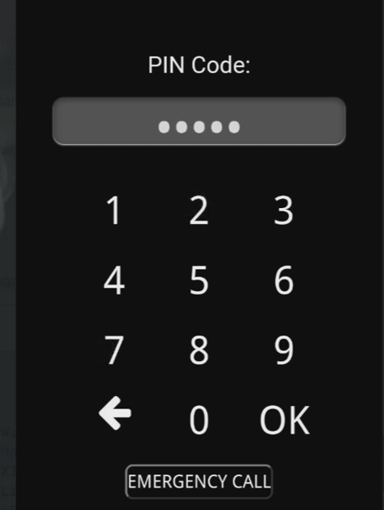


Slide 17
The pros and cons of Lockphish
Lockphish is an extremely versatile tool for collecting a target’s device login credentials. It supports Android, iOS and Windows devices. Additionally, it is very easy for the attacker to use, setting up its own phishing servers (using ngrok) and automatically storing device credentials in a file for future use.

Slide 18
The pros and cons of Lockphish
That said, Lockphish is far from a perfect tool for phishing login credentials. Some limitations of Lockphish are:
Odd landing page: The landing page for the phishing email requires a click on a redirect link on an otherwise blank page
Click then lock: The user needs to take action on a webpage and then is immediately presented with a lock screen, presumably from a device timeout
Static background image: The lock screen background image is static, making it unlikely that it actually looks like the user’s lock screen
No PIN checking: Lockphish does not perform any verification of the user’s PIN number
Full-screen warning: Browsers on Android warn that they have entered full screen mode

Slide 19
THANK YOU

